Slide 1
Digital Innovation and Computational Thinking. ”Turning ideas into reality
24th February 2022
Lecture Five

Slide 2
Outline
Business Canvas
The nine elements

Slide 3
Business Canvas

Slide 4
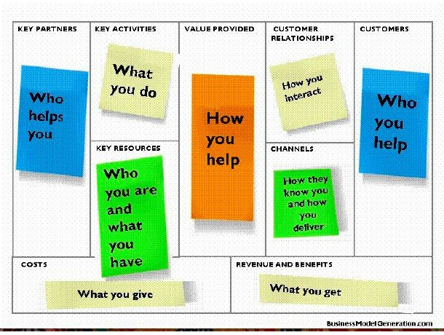

Slide 5
Nine elements of the Business Canvas
Customer Segments are the groups of people and/or organizations a company or organization aims to reach and create value for with a dedicated Value Proposition
Value Propositions are based on a bundle of products and services that create value for a Customer Segment
Channels describe how a Value Proposition is communicated and delivered to a Customer Segment through communication, distribution, and sales Channels
Customer Relationships outline what type of relationship is established and maintained with each Customer Segment, and they explain how customers are acquired and retained

Slide 6
Revenue Streams result from a Value Proposition successfully offered to a Customer Segment
It is how an organization captures value with a price that customers are willing to pay
Key Resources are the most important assets required to offer and deliver the previously described elements
Key Activities are the most important activities an organization needs to perform well
Key Partnerships shows the network of suppliers and partners that bring in external resources and activities
Cost Structure describes all costs incurred to operate a business model
Profit is calculated by subtracting the total of all costs in the Cost Structure from the total of all Revenue Streams.

Slide 7
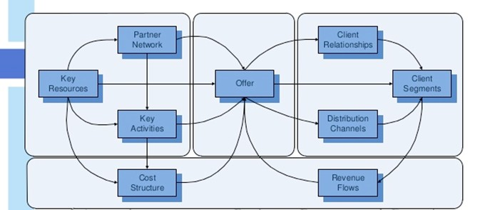
How the none elements Relate

Slide 8
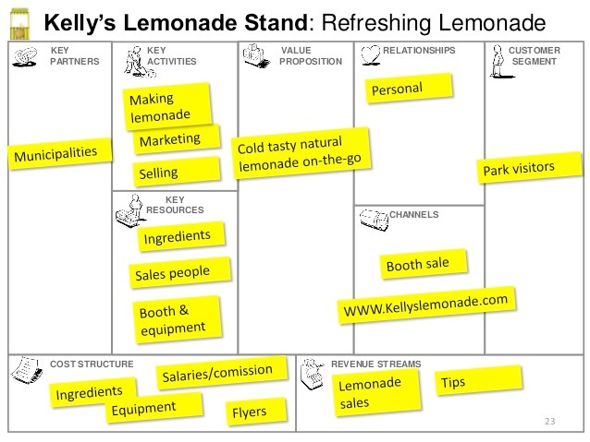
Example business canvas

Slide 9
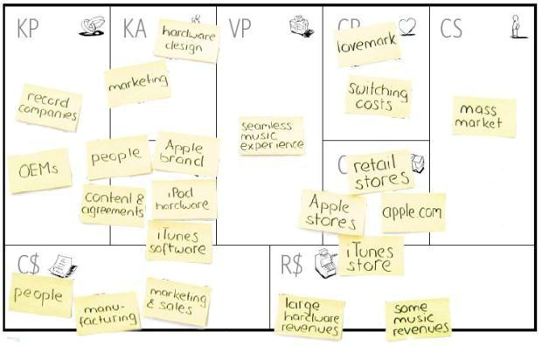
Apple Music Business Model

Slide 10
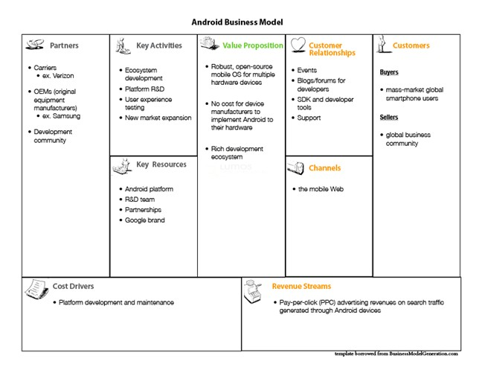

Slide 11
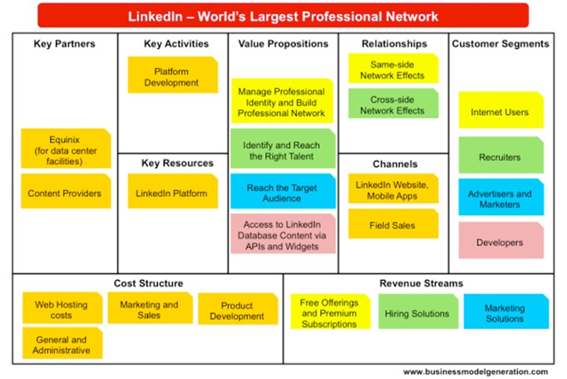

Slide 12
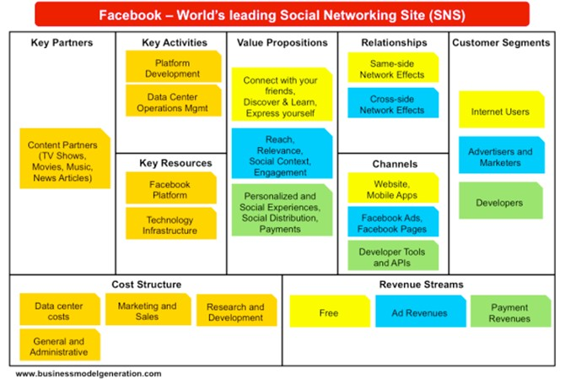

Slide 13
BMC for Evidence Based mHealth (EBmH)
A global mobile app health platform which offers an app certification program and connects healthcare payers to app developers and tech companies. The end goal is evidence-based co-creation and application of mobile health solutions to improve population health
Value proposition EBmH (Evidence-Based Mobile Health) is a global mobile health platform and app store which aims to fill the gap that currently exists for certified health apps

Slide 14
Description of the solution components
A set of processes/standards on how health apps should be evaluated (quality, content, effectiveness and safety of the app for its intended use in a specific population)
A way of certifying and curating apps so that health care payers and providers who wish to utilise mobile health apps for their populations are able to ascertain quickly the apps which are most likely to be of value
An efficient marketplace where apps with proven effectiveness and in high demand command higher prices. Use the ‘free’ market to drive quality and innovation
Connecting and forming a community of developers (sellers) and stakeholders involved in the reimbursement of health care (purchasers), providers of health care (hospitals, doctors) and end users (patients, general community or public) to co-create useful and evidence-based health applications

Slide 15
Seven Questions to Assess the Strength of the Business Model
How easy is it for customers to switch to another company?
Is every sale a new effort or will it result in quasi-guaranteed follow-up revenues and purchases?
Are you earning revenues before you are incurring costs?
Is your cost structure substantially different and better than those of your competitors?

Slide 16
How much does your business model get customers or third parties to create value for you for free?
How easily can you grow without facing roadblocks (e.g., infrastructure, customer support, hiring)?
How much is your business model protecting you from your competition?

Slide 17
Tutorials
Business Model Canvas Explained:
https://www.youtube.com/watch?v=QoAOzMTLP5s
Visualizing Your Business Model:
https://www.youtube.com/watch?v=w1KP-BaC0jA
Getting From Business Idea to Business Model:
https://www.youtube.com/watch?v=wwShFsSFb-Y
Osterwalder explaining the Business Model Canvas:
https://www.youtube.com/watch?v=RzkdJiax6Tw
Example: Business Model Canvas: Gore Fabrics by Matt Terrell:
https://www.youtube.com/watch?v=G11HCP3gTQc

Slide 18
References
Osterwalder, Alexander; Pigneur, Yves; Bernarda, Gregory; Smith, Alan
Value Proposition Design: How to Create Products and Services Customers Want (Strategyzer) (Kindle Locations ). Wiley. Kindle Edition.

